Slide 1

YSC2239 Lecture 21

Slide 2
Today’s class
Decision Trees

Slide 3
Decision Trees
A Decision Tree is a very simple way to classify data. It is simply a tree of questions that must be answered in sequence to yield a predicted classification.
How many legs?
4
2
0
Can it talk?
Snake
Does it purr?
no
yes
yes
no
Kangaroo
Does it understand what it’s saying?
Cat
Dog
yes
no
Human
Parrot

Slide 4
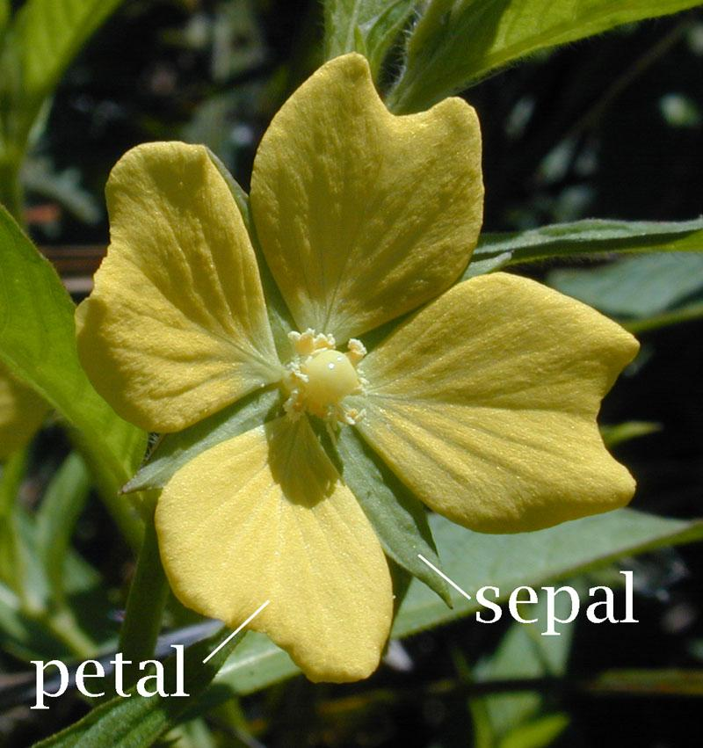
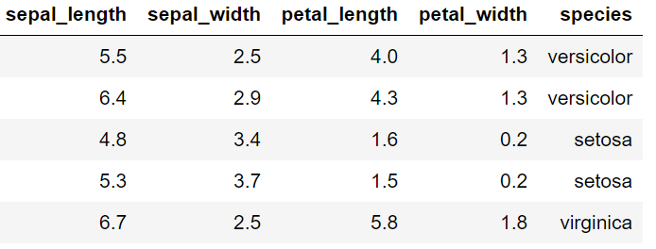
Example: Flower Classification
The Iris flower data set is a commonly used example:
Created by statistician/biologist Ronald Fisher for his paper “The use of multiple measurements in taxonomic problems”.
Data set consists of 150 flower measurements from 3 different species.
For each, we have “petal length”, “petal width”, “sepal length”, “sepal width”.
Goal is to predict species from other data.
https://en.wikipedia.org/wiki/Sepal

Slide 5
Decision Tree Basics

Slide 6
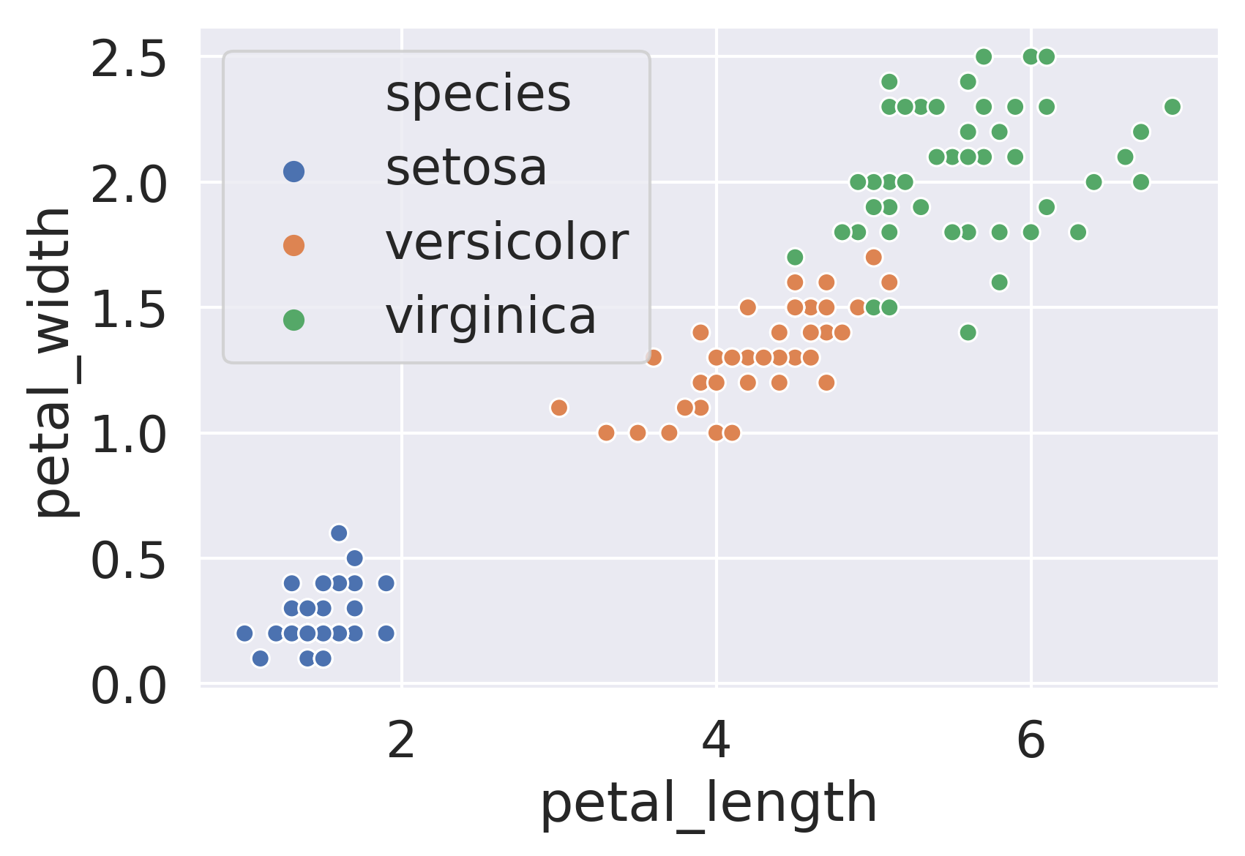
Example: Using Petal Data Only
The plot below shows the width and length of the petals of each flower, with the species annotated in the form of color.
We can build a decision tree manually just by looking at this picture.

Slide 7
Example: Using Petal Data Only

Slide 8
Example: Using Petal Data Only
Is petal_width < 0.75 and petal_length < 2?
no
yes

Slide 9
Example: Using Petal Data Only
Is petal_width < 0.75 and petal_length < 2?
no
yes
setosa

Slide 10
Example: Using Petal Data Only
Is petal_width < 0.75 and petal_length < 2?
no
yes
Is petal_width >= 1.75
setosa

Slide 11
Example: Using Petal Data Only
Is petal_width < 0.75 and petal_length < 2?
no
yes
Is petal_width >= 1.75
setosa
yes
virginica

Slide 12
Example: Using Petal Data Only
Is petal_width < 0.75 and petal_length < 2?
no
yes
Is petal_width >= 1.75
setosa
yes
no
virginica
Is pedal_width <= 1.55 and pedal_length <= 4.95

Slide 13
Example: Using Petal Data Only
Is petal_width < 0.75 and petal_length < 2?
no
yes
Is petal_width >= 1.75
setosa
yes
no
virginica
Is pedal_width <= 1.55 and pedal_length <= 4.95
yes
versicolor

Slide 14
Example: Using Petal Data Only
Is petal_width < 0.75 and petal_length < 2?
no
yes
Is petal_width >= 1.75
setosa
yes
no
virginica
Is pedal_width <= 1.55 and pedal_length <= 4.95
no
yes
Is petal_width <= 1.65 or petal_length >= 4.95
versicolor

Slide 15
Example: Using Petal Data Only
Is petal_width < 0.75 and petal_length < 2?
no
yes
Is petal_width >= 1.75
setosa
yes
no
virginica
Is pedal_width <= 1.55 and pedal_length <= 4.95
no
yes
Is petal_width <= 1.65 or petal_length >= 4.95
versicolor
yes
virginica

Slide 16
Example: Using Petal Data Only
Is petal_width < 0.75 and petal_length < 2?
no
yes
Is petal_width >= 1.75
setosa
yes
no
virginica
Is pedal_width <= 1.55 and pedal_length <= 4.95
no
yes
Is petal_width <= 1.65 or petal_length >= 4.95
versicolor
no
yes
Is petal_length <= 5.55
virginica

Slide 17
Example: Using Petal Data Only
Is petal_width < 0.75 and petal_length < 2?
no
yes
Is petal_width >= 1.75
setosa
yes
no
virginica
Is pedal_width <= 1.55 and pedal_length <= 4.95
no
yes
Is petal_width <= 1.65 or petal_length >= 4.95
versicolor
no
yes
Is petal_length <= 5.55
virginica
no
yes
virginica
versicolor

Slide 18
Example: Using Petal Data Only
How accurate is our decision tree model on the training data?
Is this good or bad?

Slide 19
Example: Using Petal Data Only
How accurate is our decision tree model on the training data?
It seems like it gets every point correct
Is this good or bad?
I’d argue bad
Seems likely to result in overfitting!
First, let’s see how we can build decision trees for classification using scikit-learn

Slide 20
Decision Trees in scikit-learn

Slide 21
Decision Tree Models With scikit-learn
The code to build a decision tree model in scikit-learn is very similar to what we saw for building linear and logistic regression models:

Slide 22

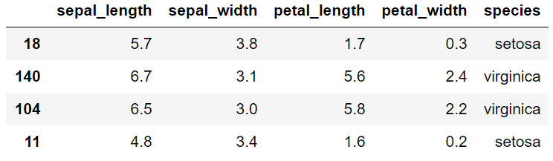
Decision Tree Models With scikit-learn
The code to build a decision tree model in scikit-learn is very similar to what we saw for building linear and logistic regression models:

Slide 23
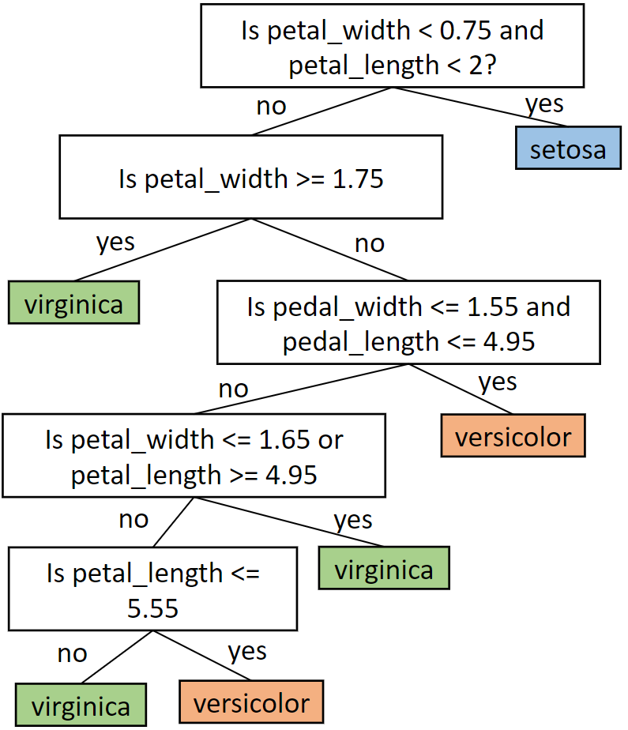
Visualizing Decision Tree Models
Suppose we want to visualize the decision tree, similar to what we saw earlier:

Slide 24
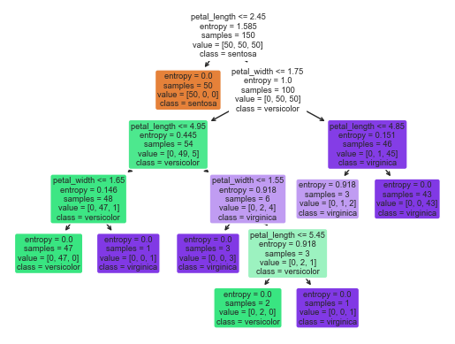
Visualizing Decision Tree Models – default
There is a built in DecisionTree visualizer
Unfortunately, it isn’t very good

Slide 25
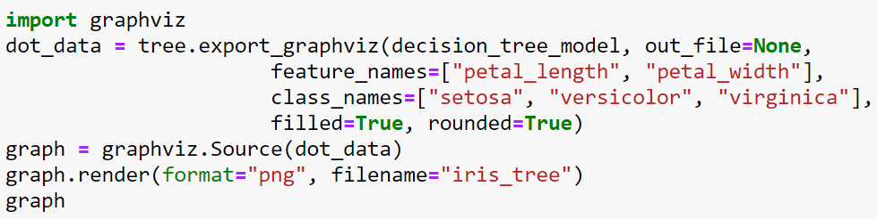
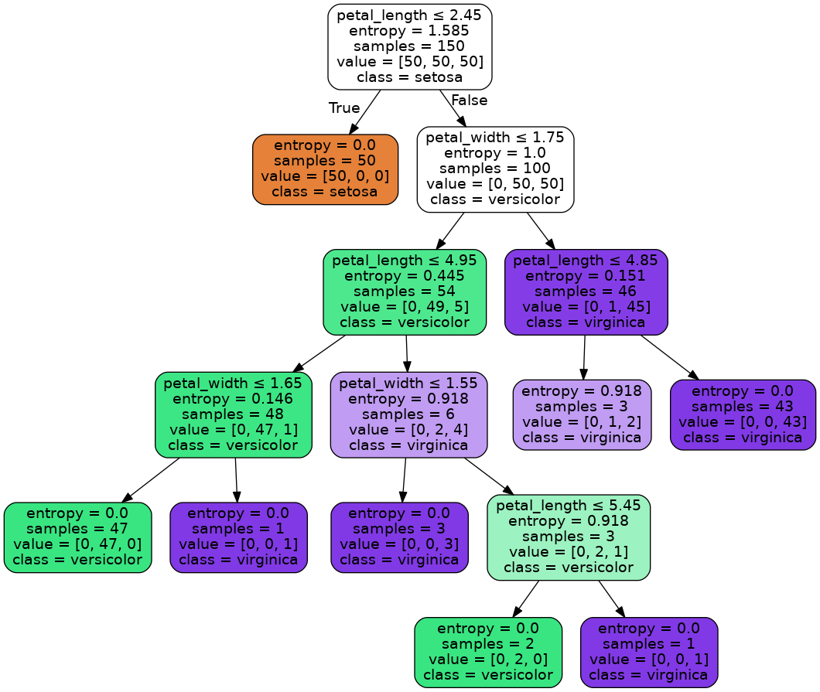
Visualizing Decision Tree Models - use GraphViz
Can use GraphViz to get a much nicer picture.
In each box, we see:
The rule.
The entropy at that node (more later).
The number of samples that remain after applying all of the above rules.
The number of samples that remain.
The most likely class.
Notes:
Luckily there is an even better Library called export graphviz, which uses the AT&T graphviz Library make a much nicer layout. Code for doing so Is shown on the screen.
We noticed this visualization has a lot of annotations in each box.
For rules which represent yes/no questions, the first thing in the box is the question. For example at the root note we have a question is the pedal length less than or equal to 2.45?
Looking at all of the boxes, you'll see that they only ever use one of the features. Unlike the decision tree that we manually created earlier, which had rules that had conditions like “is petal_length < 3 and petal_width > 2”, scikit-learn decision trees only ever consider a single feature at a time.
The next box is the entropy, which we’ll discuss in a later video.
Next let's consider the line that says samples. In the root samples is equal to 150. This means that when the decision tree was trained, there were 150 total samples. In the node to the left of the root, we see there only 50 samples left. these are the 50 samples for which the rule above was true. By contrast the right child of the root node has 100 samples, these are the samples whose petal length was not less than or equal to 2.45.
below the samples line is a list called value. This provides the number of samples in each class that remain after applying all of the rules above the current node. for example, for the node with 50 samples that we just considered, all 50 samples belong to the left class, and 0 samples belong to the middle and right class. by contrast, in the 100 sample node that we just considered, 0 samples are in the left class, 50 samples are in the middle class and 50 samples are in the right class.
That last label in each node “class”, represents the most likely class given the knowledge that is available to us by the time we reach this note in the decision tree. For example consider this node which has 54 samples, 49 in the middle class, and five nodes in the right class. The most likely class is the middle class, after all 49 out of 54 samples belong to this class. And what class is that? it is the versicolor class, thus this node is labeled versicolor.
next consider the color of each node. The color reflects the most likely class for each node. the darker the color, the more confident the model is in that classification. Note that two of the nodes have absolutely no color whatsoever, this is because there is no majority class, in other words there is a tie.

Slide 26
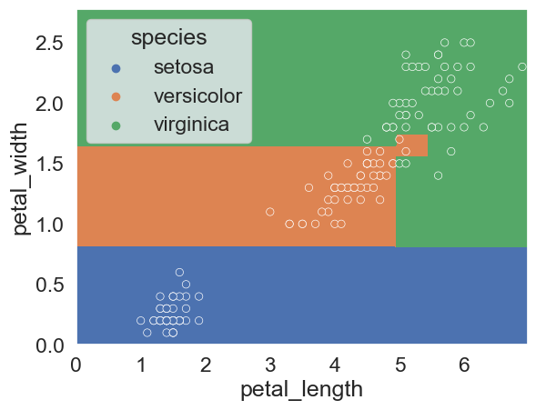
Visualizing Decision Boundary for Decision Tree
Plotting the decision boundaries for decision tree models, we get the results below.
Decision tree has nonlinear boundary, and appears to get 100% accuracy.
Let’s calculate the exact accuracy rather than just relying on our eyes to look at a somewhat complex visualization.
Notes:
let's compare the decision boundaries of a scikit-learn logistic regression model with a decision tree model. We observe that unlike the logistic regression model boundaries, the decision trees boundaries are nonlinear. Furthermore we have observed that we seem to be getting 100% accuracy. In the next video we will actually compute the accuracy rather than looking at it by eye.

Slide 27
Measuring the Performance of Our Model
Running the code below, we see that we only get 99.3% accuracy
https://scikit-learn.org/stable/modules/generated/sklearn.metrics.accuracy_score.html
To understand why, let’s look back at our decision tree model.

Slide 28
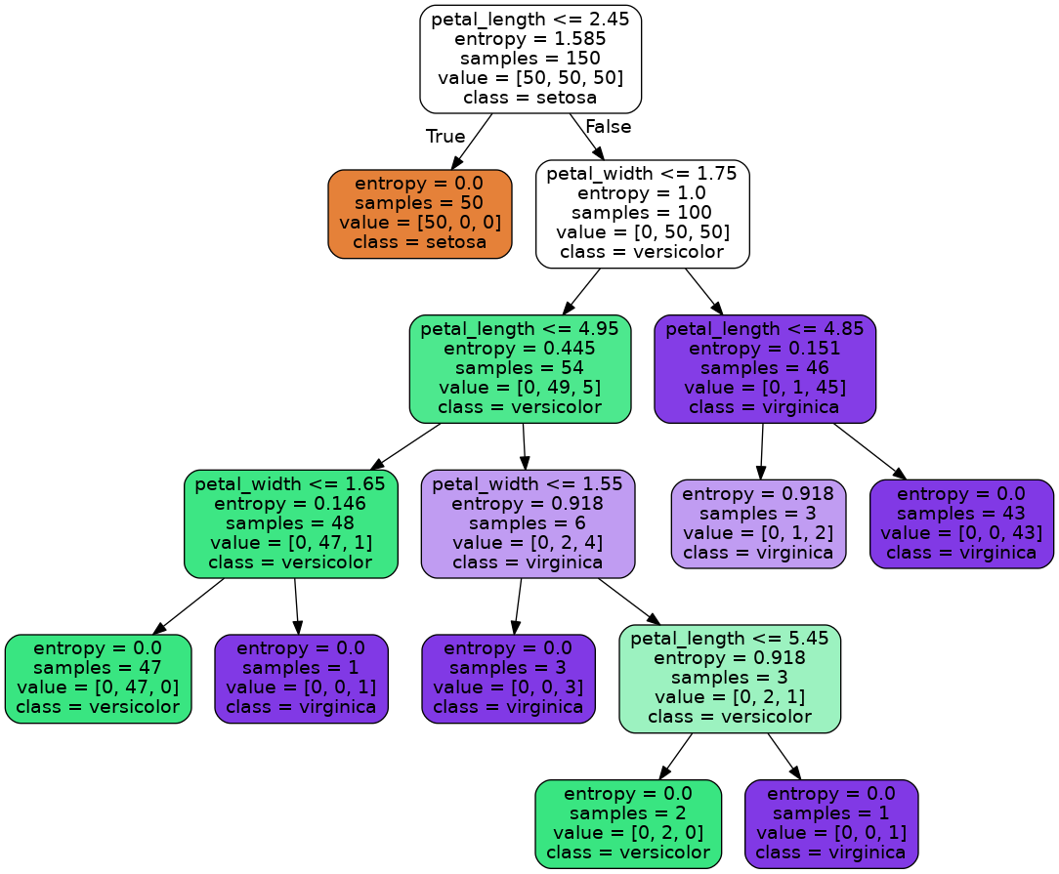
Understanding Our Decision Tree
There is one terminal decision point where there is more than one possible right answer.
Can you find it?
Notes:
To understand why our tree does not have 100% accuracy, let's look carefully at the visualization of our decision tree. There is one terminal decision point in the tree where there is more than one possible right answer. Pause the video and try to find it.

Slide 29
Understanding Our Decision Tree
There is one terminal decision point where there is more than one possible right answer.
The model was unable to come up with a decision rule to resolve these last 3 samples.
Let’s see why using the query method of the dataframe class.
Notes:
Here we observe that there is one three sample node at the end of the tree which is “impure”. That is, it has samples from more than one class. For some reason scikit-learn gave up, and didn't create a rule to differentiate the samples.

Slide 30
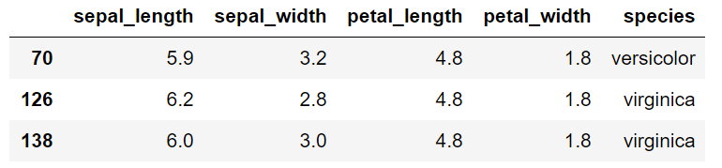
Understanding Our Decision Tree
There is one terminal decision point where there is more than one possible right answer.
In the original data set, there was a versicolor iris with the same petal measurements as two virginicas.
Notes:
We can call dot query, echoing each of our decision tree rules in turn. hey dataframe, give me all your data points where the petal length is > 2.45, and where the petal width is > 1.75, and where the petal length is < 4.85. when we do this we get back three data points. and if we look closely, we see that all three of these have the exact same petal length and petal width, 4.8 and 1.8 respectively. however not all three of these flowers are of the same species. Given just these two features, it is impossible to differentiate these flowers.

Slide 31
Overfitting

Slide 32
Overfitting and Decision Trees
sk-learn decision trees will always have perfect accuracy on the training data, EXCEPT when there are samples from different categories with the exact same features.
Example: If the versicolor above had a petal_length of 4.8001, we’d have 100% training accuracy.
This tendency for perfect accuracy should give us concern about overfitting.
Model is extremely sensitive / has high variance.
Notes:
we can generalize what we've observed with the following statement. scikit learn decision trees always have perfect accuracy on the training data, except when there are samples from different classes with the exact same features. If the versicolor in our table above had a petal length of 4.8001, we have 100% training accuracy.
This tendency for these type of models have perfect training accuracy should give us grave concern about overfitting.

Slide 33
Sepal Decision Tree
In order to understand how to avoid overfitting, let’s first discuss how decision trees are created from data.
Traditional decision tree generation algorithm:
All of the data starts in the root node.
Repeat until every node is either pure or unsplittable:
Pick the best feature x and best split value β, e.g. x = petal_length, β = 2.
Split data into two nodes, one where x < β, and one where x ≥ β.
Notes: A node that has only one samples from one class is called a “pure” node. A node that has overlapping data points from different classes and thus that cannot be split is called “unsplittable”.
Notes:
The traditional decision tree generation algorithm is as follows. All of the data starts in the root note. We repeat until every note is either Pure or unsplittable. First we pick the best feature X, and the best split value beta, for example x = petal_length, beta = 2. We then split the data into two notes, one where x < beta, and one where x >= beta.
A pure node is defined as a node that only has samples from one class. We define an unsplittable node as a node that has overlapping data points from different classes and thus that cannot be split.
Here, we have not yet defined what we mean when we say best.

Slide 34
Defining a Best Feature
Question: Which feature and split value is best?
Equivalently: Which horizontal or vertical line do we want to draw?
????
[50, 50, 50]
No
Yes
????
[??, ??, ??]
????
[??, ??, ??]
Notes:
Let’s explore the notion of a best split intuitively. When we start, all of the samples are in the root node, 50 from each class. There are many potential splitting lines we could draw.

Slide 35
Defining a Best Feature
Question: Which feature and split value is best?
Equivalently: Which horizontal or vertical line do we want to draw?
width ≥ 1.5
[50, 50, 50]
No
Yes
????
[50, 35, 1]
????
[0, 15, 49]
Is this good?
Notes:
For example we could draw the line separating petal_width < 1.5 and petal_width >= 1.5. This yields, on the yes side, 0 setosas , 15 versiciolors, 49 virginicas, and the remaining 86 samples on the no side. Note that if you try to count the number of flowers of each type from this figure, you won’t arrive at these numbers because there are many overlapping data points. For example, there are multiple versicolors with the exact same length and width as each other.

Slide 36
Defining a Best Feature
Question: Which feature and split value is best?
Equivalently: Which horizontal or vertical line do we want to draw?
width ≥ 1.5
[50, 50, 50]
No
Yes
????
[50, 35, 1]
????
[0, 15, 49]
Is this good? It does help, but we could do better!
Notes:
Is this a good split? well it is at least a little useful. For example, it sticks most of the virginicas in a single class.

Slide 37
Defining a Best Feature
Question: Which feature and split value is best?
Equivalently: Which horizontal or vertical line do we want to draw?
Better than before??
length ≥ 4
[50, 50, 50]
No
Yes
????
[50, 11, 0]
????
[0, 39, 50]
Notes:
We could also try a different choice. For example, this vertical line separating points with petal lengths greater than or equal to 4. Arguably this line is better than our previous choice of line. It feels intuitively better to me because all of the virginicas are in one node.

Slide 38
Defining a Best Feature
Question: Which feature and split value is best?
Equivalently: Which horizontal or vertical line do we want to draw?
width ≥ 0.5
[50, 50, 50]
No
Yes
????
[2, 50, 50]
????
[48, 0, 0]
Even better?
Notes:
Another split we might try is whether the width is greater than or equal to 0.5 or not. this split seems intuitively even better. It keeps 48 of the setosas together, and the remaining 102 samples are on the other side.

Slide 39
Defining a Best Feature
Question: Which feature and split value is best?
Equivalently: Which horizontal or vertical line do we want to draw?
We need some sort of rigorous definition for a good split.
width ≥ 0.8
[50, 50, 50]
No
Yes
????
[50, 0, 0]
????
[0, 50, 50]
Best?
Notes:
And of course, we can choose a horizontal or vertical line the totally separates the setosas, for example, width >= 0.8.
Intuitively, this Choice seems like the best one.
We’d like an algorithm that can automatically conduct this process of considering different splits. Beforee we can do that, we need some sort of rigorous definition for a good split.

Slide 40
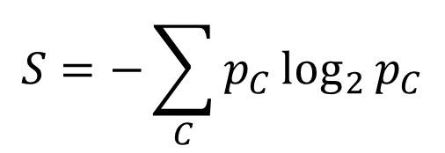
Node Entropy
Let 𝑝_{𝐶} be the proportion of data points in a node with label C.
For example, for the node at the top of the decision tree, 𝑝₀ = 34/110 = 0.31, 𝑝₁ = 36/110 = 0.33, and 𝑝₂ = 40/110 = 0.36.
Define the entropy S of a node (in bits) as:
For example, S for the top node is:
−0.31 log₂⁡0.31 − 0.33 log₂⁡0.33 − 0.36 log₂⁡0.36 = 0.52 + 0.53 + 0.53 = 1.58 bits
Notes:
Here we introduce the notion of node entropy. This is going to feel really arbitrary and confusing at first, but after a few examples, it’ll become clear.
First we define p sub c to be the proportion of data points in a node that have label C. For example, for the node at the top of the decision tree, 𝑝0 = 34/110 = 0.31,𝑝1 = 36/110 = 0.33, and 𝑝2 = 40/110 = 0.36.
Next we define the entropy S of a node with this equation: S equals the negative of the sum of p sub c times log base 2 of p sub c, summed over all classes C. So for example, S for the top node is: −0.31 log ⁡0.31 − 0.33 log ⁡0.33 − 0.36 log ⁡0.36. Computing these logs and multiplying out these values, we get 0.52 + 0.53 + 0.53 = 1.58

Slide 41
Test Your Understanding
What is the entropy of the node with [31, 4, 1] in each class?
𝑝₀ = 31/36 = 0.86, 𝑝₁ = 4/36 = 0.11, and 𝑝₂ = 1/36 = 0.028
S = −0.86 log₂⁡0.86
− 0.11 log₂⁡0.11
− 0.028 log₂⁡0.028 = 0.68 bits
Can think of entropy as how unpredictable a node is. Low entropy means more predictable. High entropy means less predictable.
Notes:
Here we see the answers to this question. P sub 0 is 0.86, p sub 1 is 0.11, and p sub 2 is 0.028. Applying our formula for entropy to these three values as shown on the screen, we compute an entropy value of 0.68 for this node.
we can think of entropy as how unpredictable a node is. low entropy means more predictable. High entropy means less predictable.
So for example, if we are working our way through a decision tree, at the root node shown, we have very little idea what class the sample belongs to, and thus the entropy is relatively high. By contrast, by the time we reach the left node, we know that it is very likely a setosa, and thus the entropy is lower.

Slide 42
Weighted Entropy
Define the weighted entropy of a node as its entropy scaled by the fraction of the samples in that node.
Consider our decision tree to the right.
Weighted entropy of the node with 54 samples is WS = 54/150 * 0.445 = 0.16.
Weighted entropy of the terminal node with 3 samples is 3/150 * 0.918 = 0.018
WS=0.16
WS = 0.018
Notes:
We saw earlier that any given point in the decision tree generation algorithm, we have choices we can make, e.g. do we want to split based on the question “ is petal length >= 4?” or “is sepal_length >= 0.5?” or whatever else. How do we decide which splitting rule is better?
Sklearn uses a concept known as the “weighted entropy” as part of its decision making process. The weighted entropy of a node is simply its entropy times the fraction of the samples that in that node. We use the symbol WS to represent the weighted entropy.
As an example, the entropy S of the node with 54 samples is 0.445. However, the weighted entropy, WS, of the node with 54 samples is 54/150 * 0.445 = 0.16.
As another example, the weighted entropy WS of this terminal node with 3 samples is 3/150 * 0.918 = 0.018,
Note that the weighted entropy of the root is just the entropy, i.e. 1.585 * 150 / 150. In other words, WS and S are the same for the root since the root contains all of the samples.

Slide 43
Defining a Best Feature
Split choice #1: width ≥ 1.5. Compute entropy of child nodes:
entropy([50, 50, 50]) =1 , weighted entropy = 150/150 * 1 = 1.58
entropy([50, 35, 1]) = 1.06, weighted entropy = 86/150 * 1.06 = 0.61
entropy([15, 49]) = 0.79, weighted entropy = 64/150 * 0.79 = 0.34
ΔWS = 1.58 - 0.61 - 0.34 = 0.63.
S=1.58, WS=1.58
width ≥ 1.5
[50, 50, 50]
No
Yes
Not so good
????
[50, 35, 1]
????
[0, 15, 49]
S=1.06, WS = 0.61
S=0.79, WS = 0.34
ΔWS = 0.63
Notes:
Let’s use this idea to evaluate the quality of the four possible splits we discussed earlier. Our first possible split was “Is the petal width greater than or equal to 1.5”. Since the left node has 50 samples in class 0, 35 samples in class 1, and 1 sample in class 2, the resulting entropy can be computed as 1.06 using the same formula that we saw in the previous video. Scaling by the number of samples, we get a weighted entropy of WS = 0.61 for this possible left child. We then compute the entropy of the right child, and get 0.79, which yields a weighted entropy WS of 0.344. Computing delta WS, we get 1.58 - 0.61 - 0.34 = 0.63. This is the quality of this possible split, i.e. it reduces entropy by 0.63.

Slide 44
Defining a Best Feature
Split choice #2: length ≥ 4. Compute entropy of child nodes:
entropy([50, 11]) = 0.68, weighted entropy = 61/150 * 0.68 = 0.28
entropy([39, 50]) = 0.99, weighted entropy = 89/150 * 0.99 = 0.59
ΔWS = 1.58 - 0.28 - 0.59 = 0.71. Better than split choice #1 (had ΔWS = 0.63).
S=1.58, WS=1.58
length ≥ 4
[50, 50, 50]
No
Yes
????
[50, 11, 0]
????
[0, 39, 50]
S=0.68, WS=0.28
S=0.99, WS=0.59
Better?
ΔWS = 0.71
Notes:
The next split that we considered was “Is the petal length greater than or equal to 4”. Here, the potential left child has entropy 0.68, which yields a weighted entropy of 0.28, and the right child has entropy 0.99, which yields a weighted entropy of 0.59. I won’t read off the rest of the math here to avoid being boring, but the ultimate result is that this split has a delta WS of 0.71, i.e. the entropy is reduced by 0.71.

Slide 45
Defining a Best Feature
Split choice #3: width ≥ 0.5. Compute entropy of child nodes:
entropy([2, 50, 50]) = 1.12, weighted entropy = 0.68 * 1.12 = 0.76
entropy([48]) = 0, weighted entropy = 0
ΔWS = 1.58 - 0.76 = 0.82. Better than split choice #2 (had ΔWS = 0.71).
S=1.58, WE = 1.58
width ≥ 0.5
[50, 50, 50]
No
Yes
????
[2, 50, 50]
????
[48, 0, 0]
S=1.12, WS=0.76
S=0, WS=0
Even better?
ΔWS = 0.82
Notes:
The third split that we considered was “Is the petal width greater than or equal to 0.5”. Here, the potential left child has entropy 1.12, with weighted entropy 0.76, and the right child has entropy 0, since all samples belong to one class. For this choice of split, the delta WS is 0.82, which is even better than our second split choice.

Slide 46
Defining a Best Feature
Split choice #4: width ≥ 0.8. Compute entropy of child nodes:
entropy([50, 50]) = 1, weighted entropy = 100/150 * 1 = 0.67
entropy([50]) = 0, weighted entropy = 50/150 * 0 = 0
ΔWS = 1.58 - 0.67 = 0.91. Better than split choice #3 (had ΔWS = 0.82).
S=1.58, WS = 1.58
width ≥ 0.8
[50, 50, 50]
No
Yes
????
[0, 50, 50]
????
[50, 0, 0]
Best?
S=1, WS = 0.67
S=0, WS = 0
ΔWS = 0.91
Notes:
Our fourth and final split under consideration was “Is the petal width greater than or equal to 0.8”. Here, the potential left child has entropy 1, and the right child has entropy 0, since again all samples belong to one class. The weighted entropy of the left child is 0.67 since it contains 100 out of 150 of the samples and 100/150 * 1 is 0.67. This results in a delta WS value of 1.58 - 0.68 or 0.91. This is the highest delta WS of any split we tried. And in fact it is the lowest possible delta WS for a single rule. Thus, if faced with just these four choices, our greedy decision tree algorithm will select this rule.

Slide 47
Decision Tree Generation Algorithm
Traditional decision tree generation algorithm:
All of the data starts in the root node.
Repeat until every node is either pure or unsplittable:
Pick the best feature x and split value β such that the ΔWS is maximized, e.g. x = petal_width, β = 0.8 has ΔWS = 0.91.
Split data into two nodes, one where x < β, and one where x ≥ β.
Notes: A node that has only one samples from one class is called a “pure” node. A node that has overlapping data points from different classes and thus that cannot be split is called “unsplittable”.
Let’s now turn our attention to avoiding overfitting.
47
47
Notes:
So returning to our description of the traditional decision tree generation algorithm, we've now resolved the one remaining mystery, namely: how did we decide that one split is better than another? And the answer we just saw is that we will pick the split with the largest delta WS.
We still have to decide which parameters and which values to consider. For small models, it’s feasible to iterate over all possibilities. If there are too many, we can choose randomly. We won’t go through the exact details of these various approaches, though you’ll get a chance to think about them on this week’s homework.
Note that it doesn’t really matter if we pick rules based on greater than or equal to or less than or equal to. In fact, whereas our algorithm used greater than or equal, sklearn uses less than or equal.

Slide 48
Overfitting and Our Algorithm
A “fully grown” decision tree built with our algorithm runs the risk of overfitting.
One idea to avoid overfitting: Don’t allow fully grown trees.
Approach 1: Set rules to prevent full growth.
Don’t split nodes with < 1% of the samples
Don’t allow nodes to be more than 7 levels deep in the tree
Approach 2: Allow full growth then prune branches afterwards.
Branch have many rules that only affect few points
Won’t discuss these in any great detail.
There’s a completely different idea called a “random forest” that is more popular and more beautiful. Won’t discuss in our course.
Notes:
There are tremendous numbers of ways that have been proposed and explored for controlling decision tree growth. the bottom line is that all you don't need to know about all of them, but… knowing about some of them will help you in the future if you're building decision trees. I should note that there's a totally different Approach to avoiding overfitting with decision trees called a random Forest. We won't talk about these today but we will discuss them in a later module.

